Slide 1
BIO 101 NOTES

Slide 2
CLASSIFICATION OF LIVING ORGANISMS
What are living organisms?
Living organisms are individuals made up of single or complex cells (made up of organelles) performing various functions of processes of live.
Living organisms possess the following characteristics :
a. Nutrition: Living organisms take in organic materials from their environment that they use for growth or provide energy. Nutrition is the process by which organisms obtain energy and raw materials from nutrients such as proteins, carbohydrates and fats.

Slide 3
CHARACTERISTICS OF LIVING ORGANISMS
b. Respiration
Respiration is the release of energy from food substances in all living cells. Living things break down food within their cells to release energy for carrying out different processes.
Movement
All living things move. Animals move from one place to another. Plants too move in various different ways.
d. Excretion
All living things excrete. As a result of the many chemical reactions occurring in cells, they have to get rid of waste products which might poison the cells.
Excretion is defined as the removal of toxic materials, the waste products of metabolism and substances in excess from the body of an organism..

Slide 4
CHARACTERISTICS OF LIVING ORGANISMS
E. Growth
Growth is seen in all living things. It involves using food to produce new cells. The permanent increase in cell number and size is called growth.
F. Reproduction
All living organisms have the ability to produce offspring.
G. Irritability
All living things are able to sense and respond to stimuli around them such as light, temperature, water, gravity and chemical substances

Slide 5
CLASSIFICATION OF LIVING ORGANISMS
TERMINOLOGIES
CLASSIFICATION is the grouping of living organisms based on similarities or differences. This sometimes refers to as biosystematics.
Taxonomy: the science of describing, naming, and classifying organisms

Slide 6
TYPES OF CLASSIFICATION
Classification can be based on two different systems:
Natural
artificial.
Natural classification
It is most often based on hierarchical classification system. It uses common features shared by organisms.

Slide 7
CLASSIFICATION
There are various sizes of groups into which living organisms are classified.
The largest group is the kingdom. There are five kingdoms: prokaryotes (which includes bacteria), protista, fungi, plants and animals.
Each kingdom is further divided into smaller groups called phyla, based on a few features that are shared by some organisms. A phylum is then subdivided into classes, orders, families, genera, and finally species.
Species is a group of organisms that can interbreed and give birth to viable offspring

Slide 8
The modern system of classification has 8 levels:
Domain
Kingdom
Phylum
Class
Order
Family
Genus
Species

Slide 9
NATURAL CLASSIFICATION
Natural classification is based on two ideas:
• homologous structures •
evolutionary relationships
Homologous structures are features of organisms that are similar in structure but may look very different from each other and may be used for different purposes.
For example, a horse’s front leg, the human arm and a bat’s wing are all homologous structures. They have the same number and arrangement of bones and this means that they probably evolved from a single type of structure that was present in a common ancestor millions of years ago.

Slide 10
NATURAL CLASSIFICATION
Evolutionary relationships is based on grouping organisms from common ancestor. It is most often correct that appearance of organisms from the same ancestor is the same or similar.
For examples, offsprings from the same parents have some characters that will be similar and inherited from their parents.

Slide 11
ARTIFICIAL CLASSIFICATION
Artificial classification uses features of organisms on the basis of presence or absence to classify organisms.
It uses the principle of pairs of options:
yes/no
has/has not
It is used for dichotomous keys in classification
For example, you could put all animals that live in water and have streamlined, fish-like bodies in the same group. This group would then include fish and whales. Whales are not fish but they put them in the category of fish based on fish-like body.

Slide 12
NOMENCLATURE
It is act of naming the organisms.
Carl Linnaeus, a Swedish botanist who lived from 1707 to 1778, introduced the hierarchical classification system.
He gave each and every species a scientific name in Latin.
The binomial system of naming species means giving organisms two names in Latin (scientific names).
The term binomial literally means two names – ‘bi’ means two and ‘nomial’ means name. Linnaeus derived scientific names from the genus and the species to which organisms belong

Slide 13
NOMENCLATURE
When writing a scientific name, the genus name is written first and starts with a capital letter, and the species name is written second and starts with a small letter.
The scientific name ought to be printed in italics when typed and underlined separately when handwritten.
The tiger belongs to the genus called Panthera and the species called tigris.
Therefore its scientific name will be typed as Panthera tigris (italics), or handwritten as Panthera tigris (underline).

Slide 14
CELLS
Cells is a basic structural and functional unit of organisms
All biologists agreed that all living organisms are made up of cells.

Slide 15
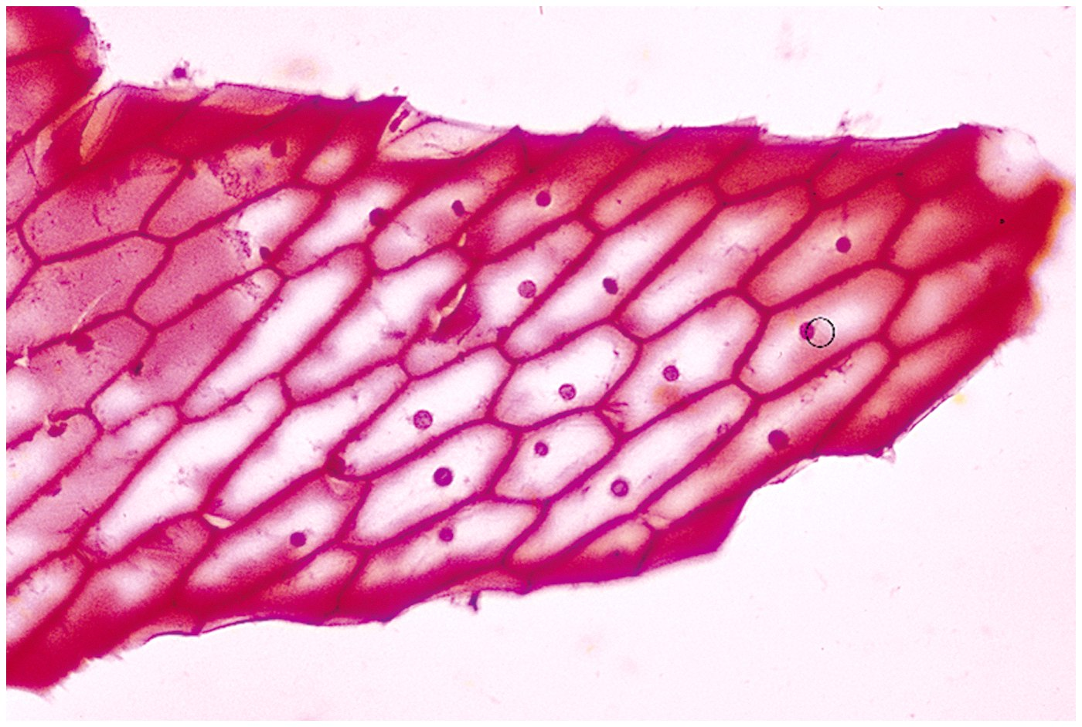
Discovery of Cells
Robert Hooke (mid-1600s)
Observed sliver of cork
Saw “row of empty boxes”
Coined the term cell

Slide 16
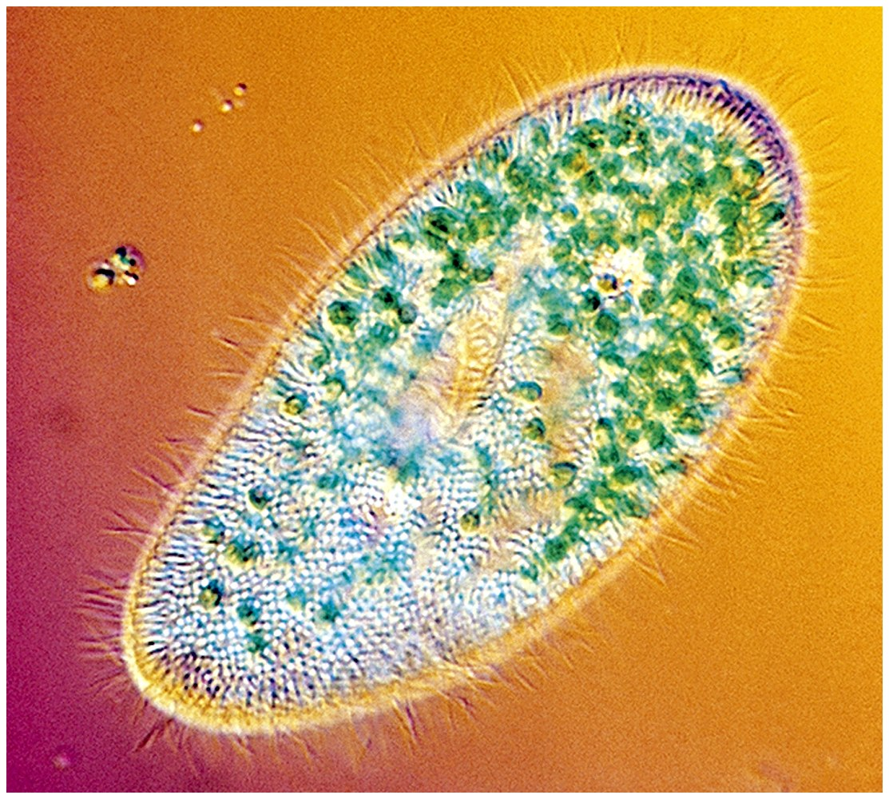
Cell theory
(1839)Theodor Schwann & Matthias Schleiden
“ all living things are made of cells”
(50 yrs. later) Rudolf Virchow
“all cells come from cells”

Slide 17
Principles of Cell Theory
All living things are made of cells
Smallest living unit of structure and function of all organisms is the cell
All cells arise from preexisting cells
(this principle discarded the idea of
spontaneous generation)

Slide 18
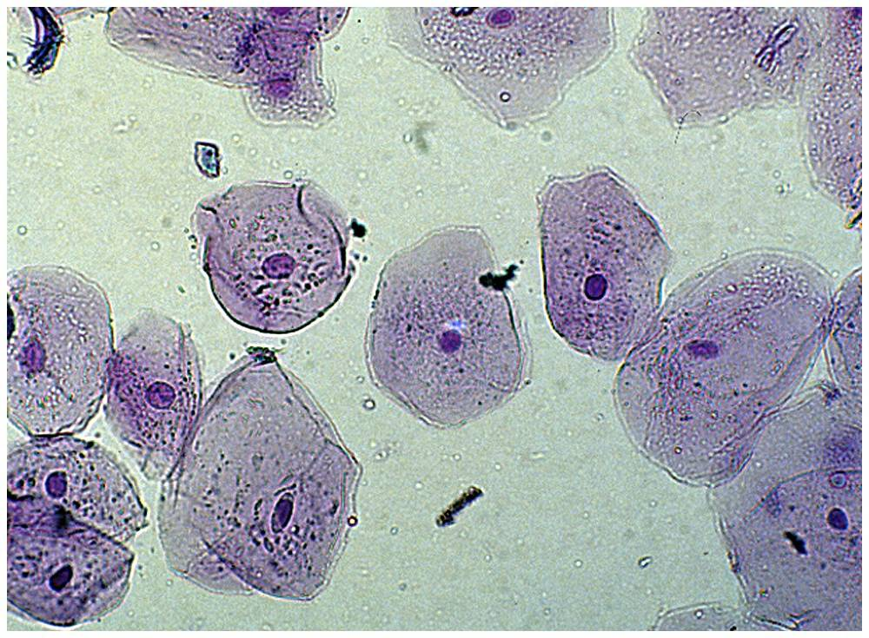
Characteristics of All Cells
A surrounding membrane
Protoplasm – cell contents in thick fluid
Organelles – structures for cell function
Control center with DNA

Slide 19
Cell Types
Prokaryotic
Eukaryotic

Slide 20
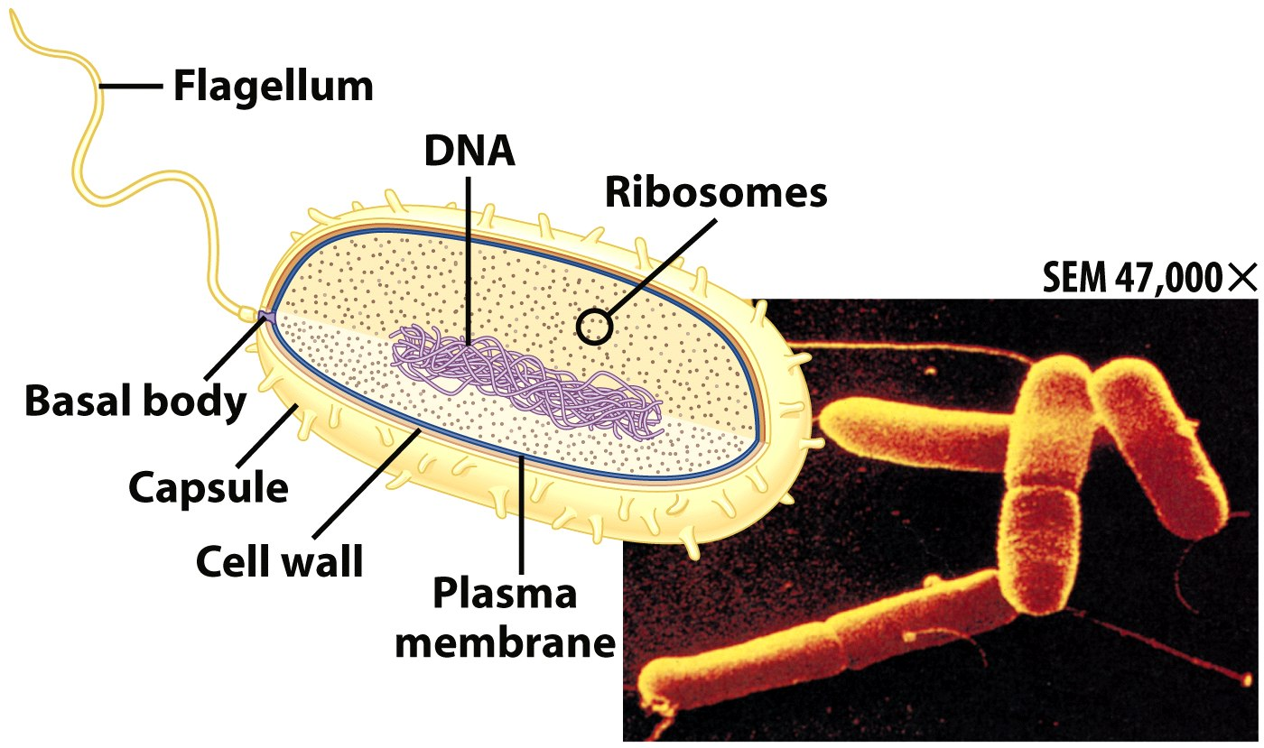
Prokaryotic Cells
First cell type on earth
Cell type of Bacteria and Archaea

Slide 21
Prokaryotic Cells
No membrane bound nucleus
Nucleoid = region of DNA concentration
Organelles not bound by membranes

Slide 22
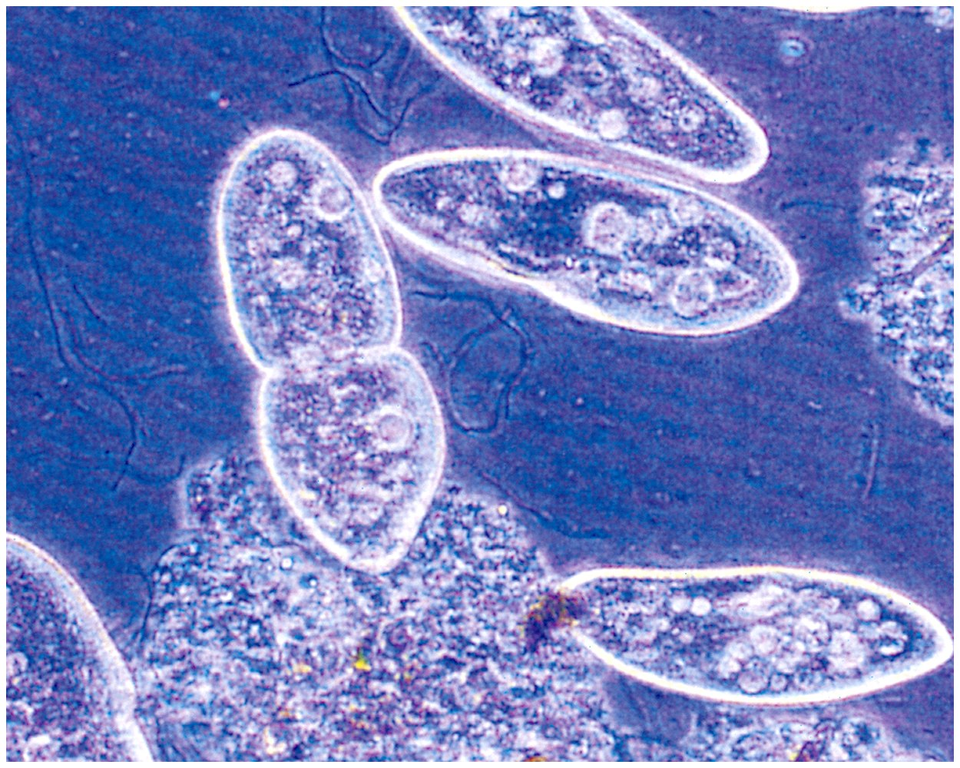
Eukaryotic Cells
Nucleus bound by membrane
Include fungi, protists, plant, and animal cells
Possess many organelles
Protozoan

Slide 23
Movement Across the Plasma Membrane
A few molecules move freely
Water, Carbon dioxide, Ammonia, Oxygen
Carrier proteins transport some molecules
Proteins embedded in lipid bilayer
Fluid mosaic model – describes fluid nature of a lipid bilayer with proteins

Slide 24
ASSIGNMENTS
What are the differences between prokaryotic and eukaryotic cells?.
Define the term organelle and state five organelles and their functions
Differentiate between plant and animal cells

Slide 25
Membrane Proteins
1. Channels or transporters
Move molecules in one direction
2. Receptors
Recognize certain chemicals

Slide 26
Membrane Proteins
3. Glycoproteins
Identify cell type
4. Enzymes
Catalyze production of substances

Slide 27
Cell Walls
Found in plants, fungi, & many protists
Surrounds plasma membrane

Slide 28
Cell Wall Differences
Plants – mostly cellulose
Fungi – contain chitin

Slide 29
Cytoplasm
Viscous fluid containing organelles
components of cytoplasm
Interconnected filaments & fibers
Fluid = cytosol
Organelles (not nucleus)
storage substances

Slide 30
Cytoskeleton
Filaments & fibers
Made of 3 fiber types
Microfilaments
Microtubules
Intermediate filaments
3 functions:
mechanical support
anchor organelles
help move substances

Slide 31
CATEGORIES OF ANIMAL CELLS
The cells in the body are classified in to four main categories, or tissues. These cells or tissues are formed from:
Epithelial Cells.
These cells are tightly attached to one another. They cover over the interior of hollow organs, like blood vessels or digestive organs, or else form the surface like the skin.
Nerve Cells. These cells are specialized for communication. They send signals from the brain to muscles and glands that control their functions. They also receive sensory information from the skin, the eyes, and the ears, and send this information to the brain. There are dozens of varieties of nerve cells in the body, each with their own shapes and functions.

Slide 32
CELLS
Muscle Cells. These cells are specialized for contraction. Without muscle cells, you would not be able to move. There are three kinds of muscle cells. They pull and tug on bones and tendons to produce motion. They also form the thick outer walls of hollow organs, like blood vessels and digestive organs, and can contract to regulate the diameter of these hollow organs.
Connective Tissue Cells. These cells provide structural strength to the body and also defend against foreign invaders like bacteria. Two types of cells—fibroblasts and fat cells—are native to connective tissue. Other cells migrate into connective tissue from the bloodstream to fight diseases. Special types of connective tissue—cartilage and bone—are designed to be stronger and more rigid than most connective tissues.

